Slide 1
Class 14:
Selfish Mining
Cryptocurrency Café
UVa cs4501 Spring 2015
David Evans

Slide 2
Plan for Today
Selfish Mining
Attacks on the Blockchain

Slide 3
Selfish Mining
Last Public Block
Mined Block!
H(PrevBlock)

Slide 4
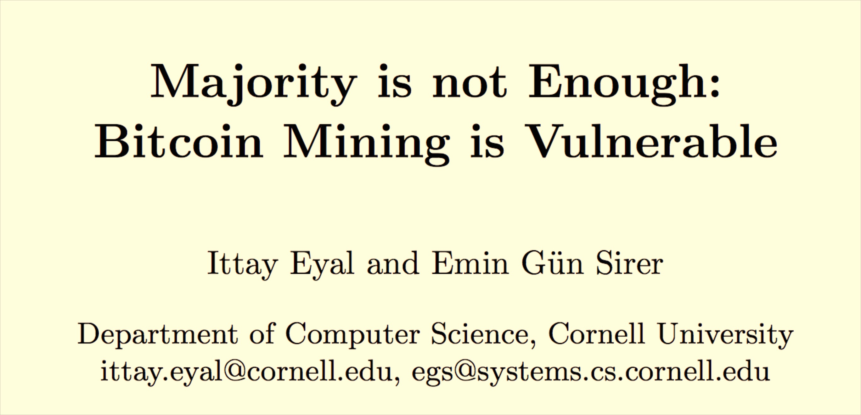
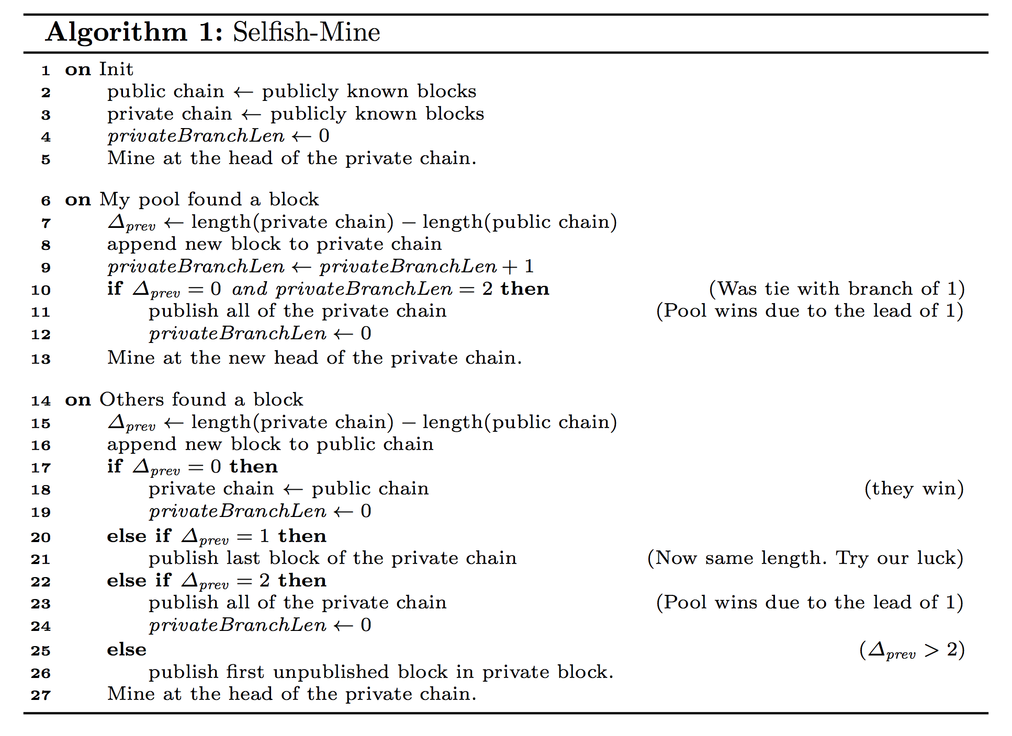

Slide 7
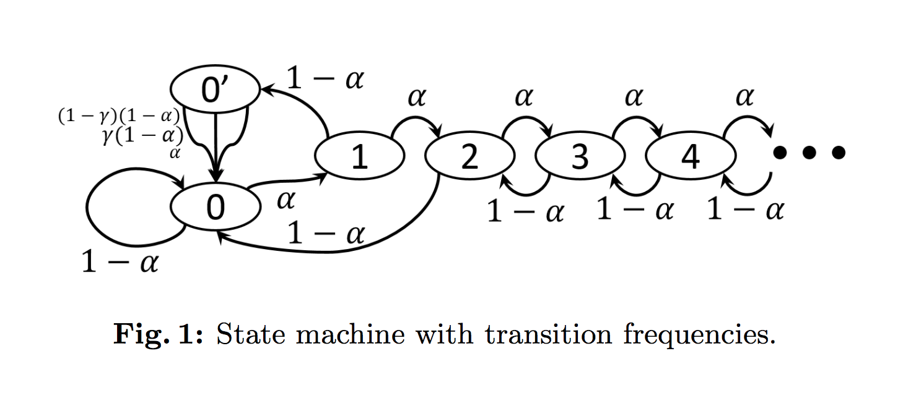
α: fraction of mining power owned by selfish pool
γ: fraction of honest miner’s that mine from selfish branch (given tie block)

Slide 8
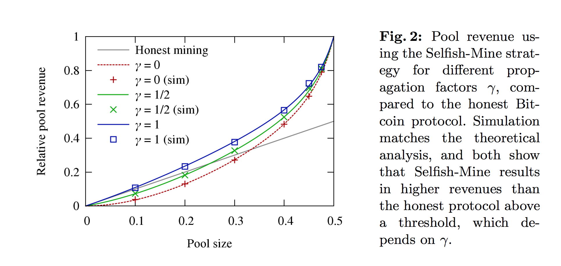

Slide 9
Proposed Solution
Now: mine first branch you hear of max difficulty
Proposed: distribute mining effort equally over all branches heard at max difficulty
(randomly choose which branch to mine)

Slide 10


Slide 11
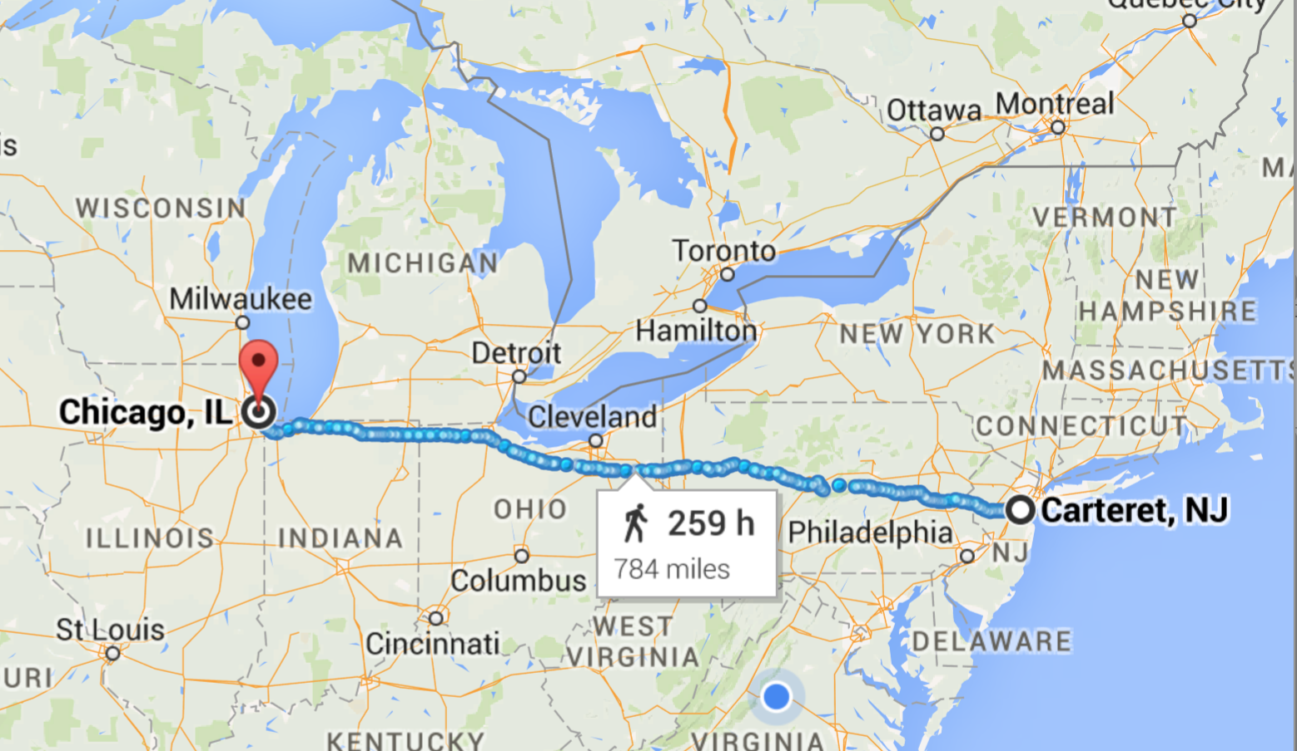

Slide 12
Normal network: 17 ms
Spread Networks ($300M): 13 ms
Chicago Mercantile Exchange
NASDAQ Data Center

Slide 13
Normal network: 17 ms
Spread Networks ($300M): 13 ms (827 miles)
Microwave Links: ~9 ms
1260 km / 299792 km/s = 4ms at lightspeed
Chicago Mercantile Exchange
NASDAQ Data Center

Slide 14
Pooling Miners
https://www.antpool.com/poolStats.htm

Slide 15
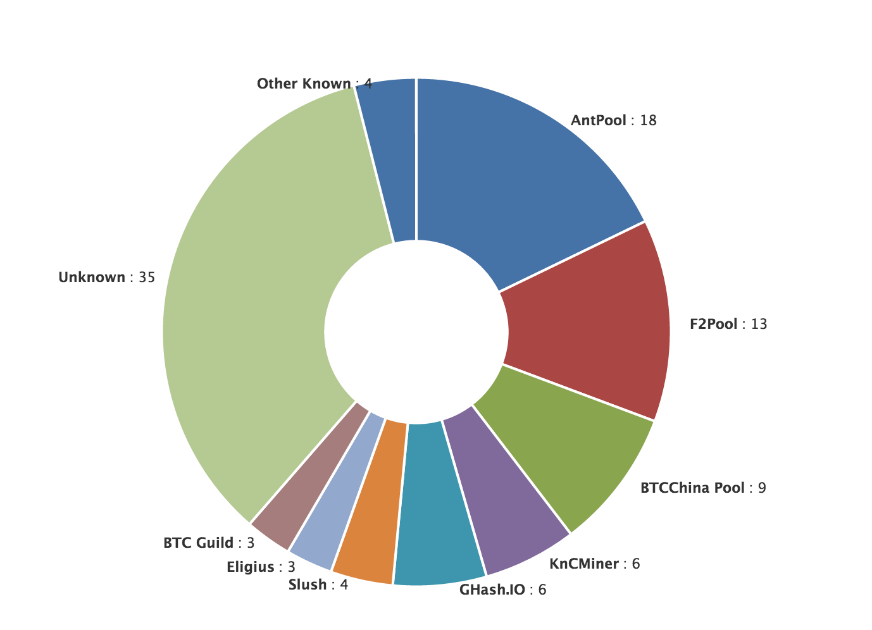
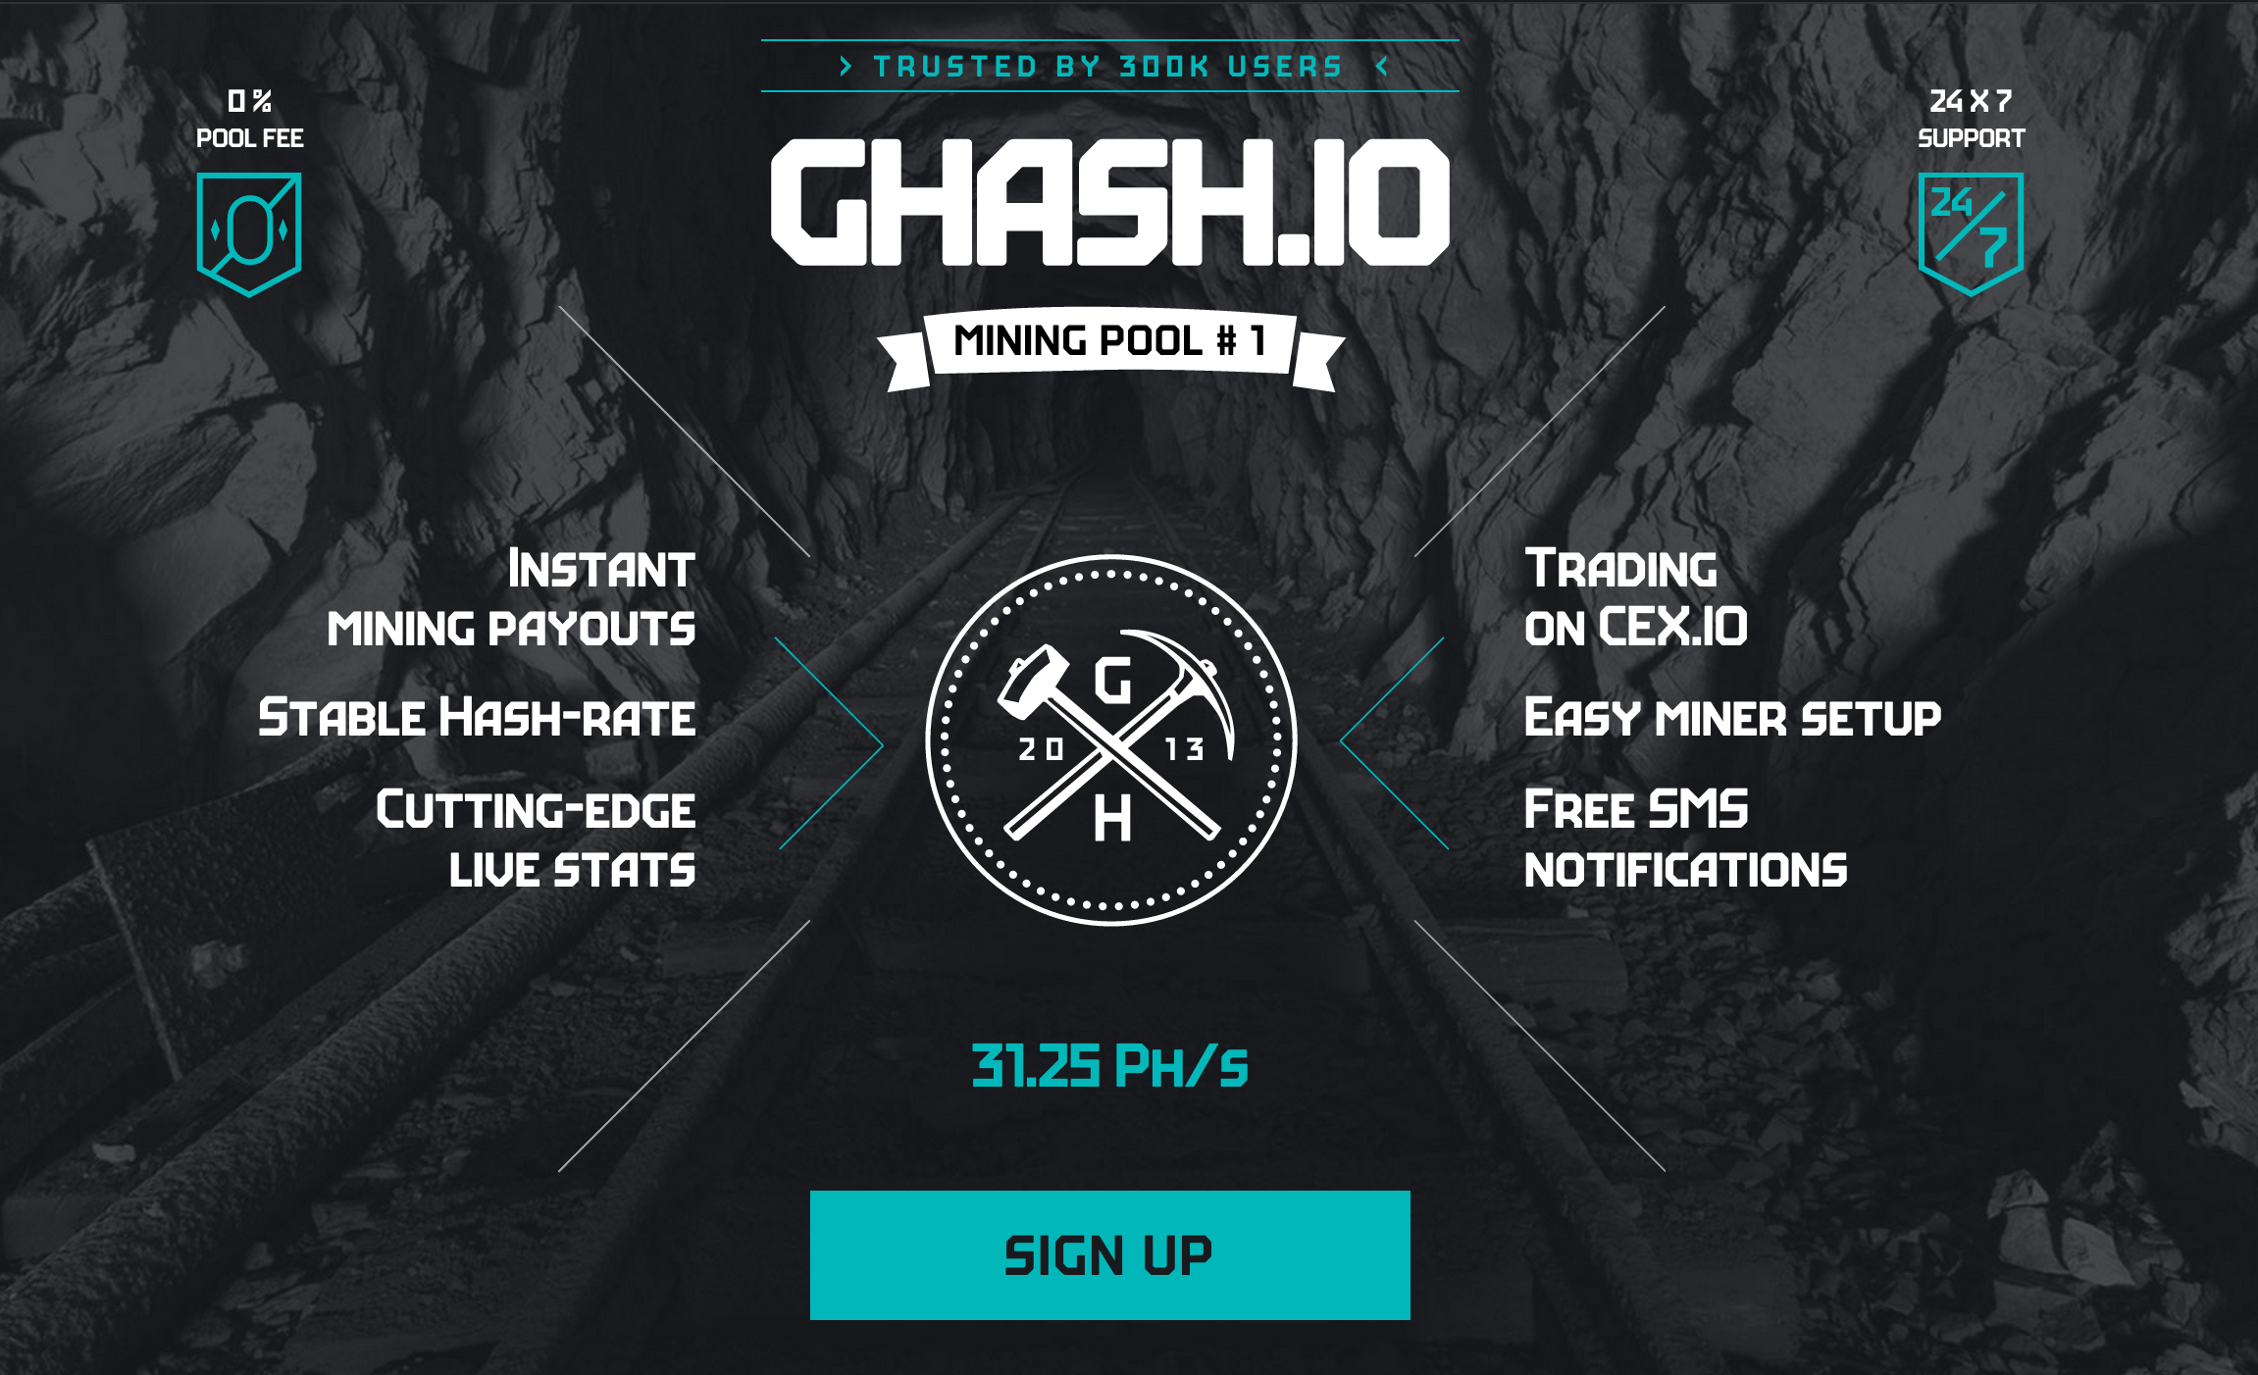
Mining Pool Dangers

Slide 16
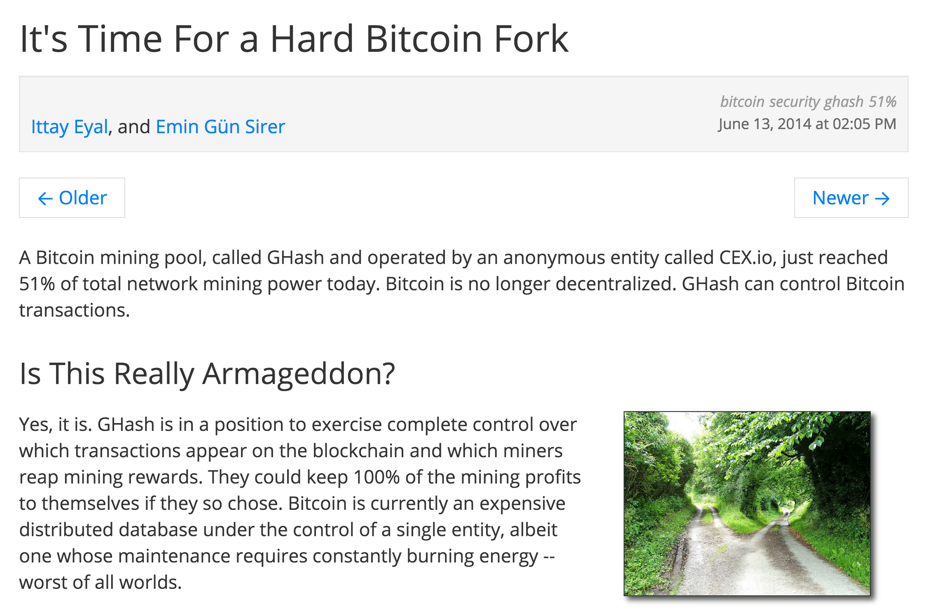

Slide 17
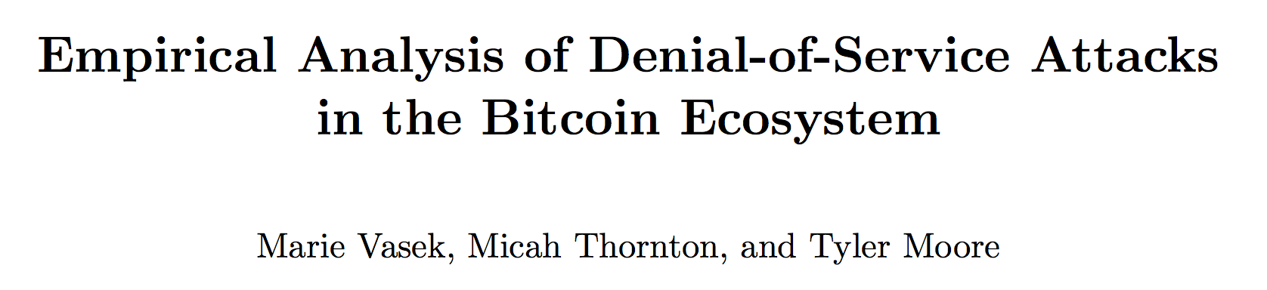
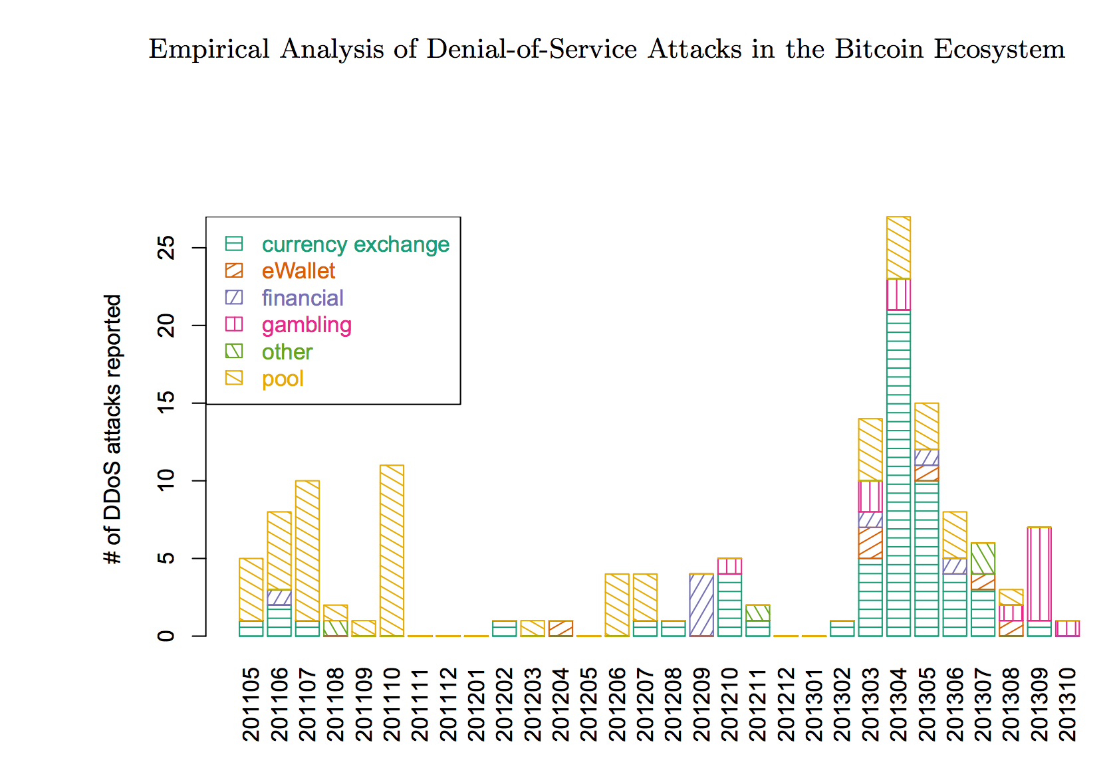
Mining Pool Attacks
DDOS-ing
Block Withholding
Lots of interesting questions about this and ongoing research…we’ll talk more in future classes. Many possible project ideas about mining pool dangers and attacks on mining pools.

Slide 18
Charge
Project 2 Part 2:
Due Thursday 5 March

